Slide 1


Slide 2

Challenges for API Integration
Did you ever need to send a POST API request to a component that constantly deploys snapshot versions of their application?
Furthermore, do you ever find yourself sending large JSON objects, and the target service has very rigid rules on the format of the JSON that keeps changing?
Challenges for Quality Assurance Teams
If a QA team prefers to save expected results in the form of JSON objects, schema changes coming in from development would require updating hundreds of expected results which often require a manual effort to update.
This is could be a big culprit for QA scheduling delays.
Challenges for Worker-Environments
In a CLI environment where applications are located in an executable package, certain applications can process hundreds of rows of JSON or AVRO records.
Formatting input records when new columns or entity-relationships are introduced is extremely tedious.

Slide 3

Schema Evolver
Schema Evolver is a tool that formats multiple JSON or AVRO records at a time to a desired format.
In order to do so it requires two schema files, each for the old and new formats.
Object Reflection
Schemas are required for this tool to work. If schemas are missing and you have classes to represent your data format, AVRO offers open-source tools for class reflection to create schemas from your old and new classes.
The Goal
To format data to simply pass it through to the next component. Any new columns or nested elements of data will be given default values or auto-generated values if a default is not specified.
Environments
This tool is most suitable as an intermediary component in a CLI environment, but it is also available in web-app form and web-service form with an API.

Slide 4
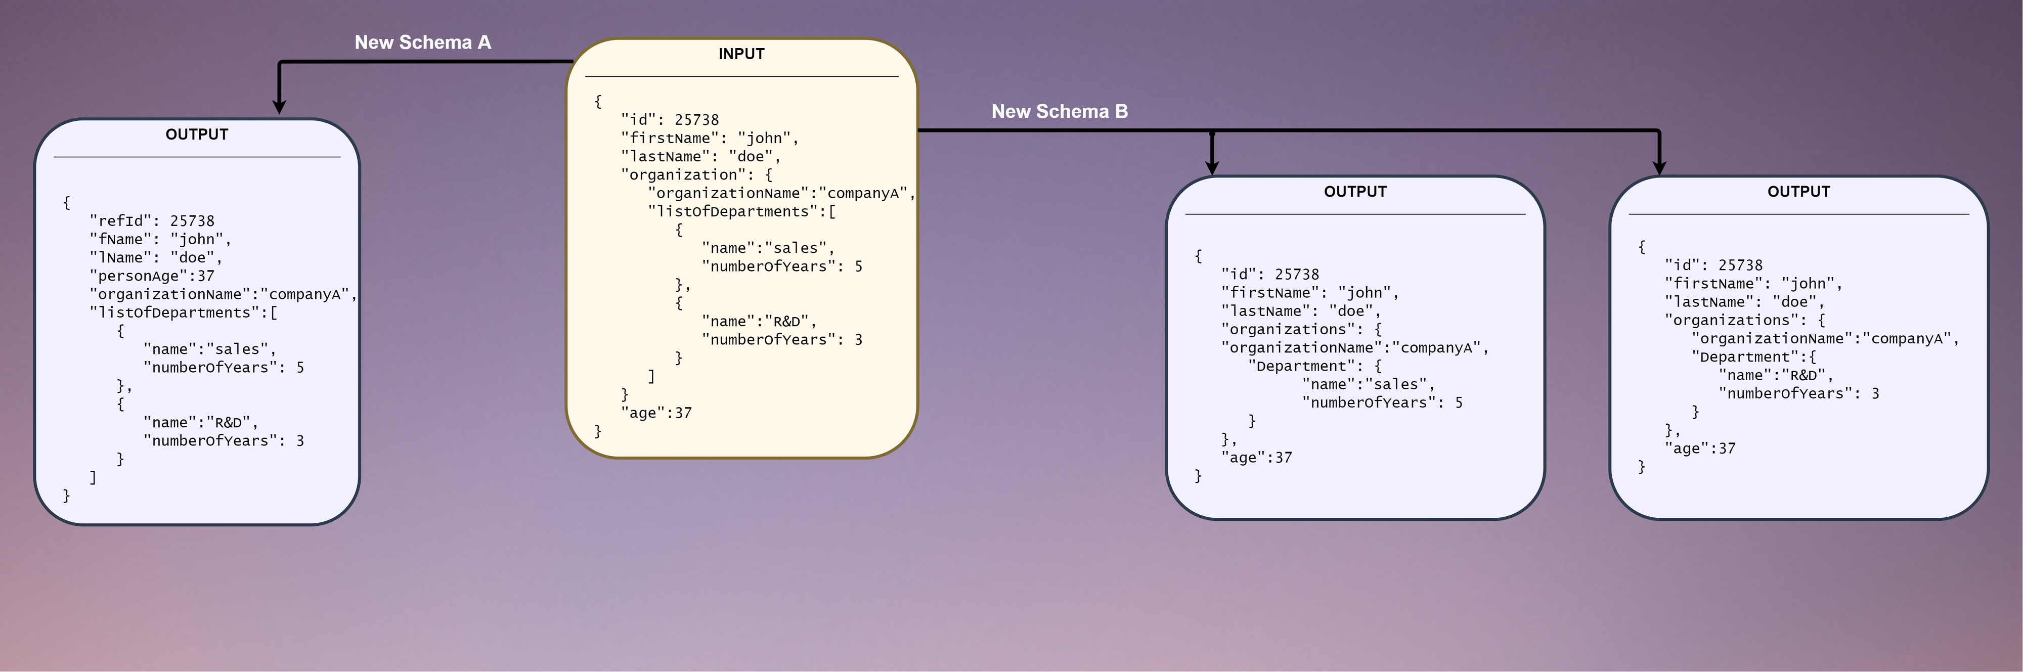

Slide 5
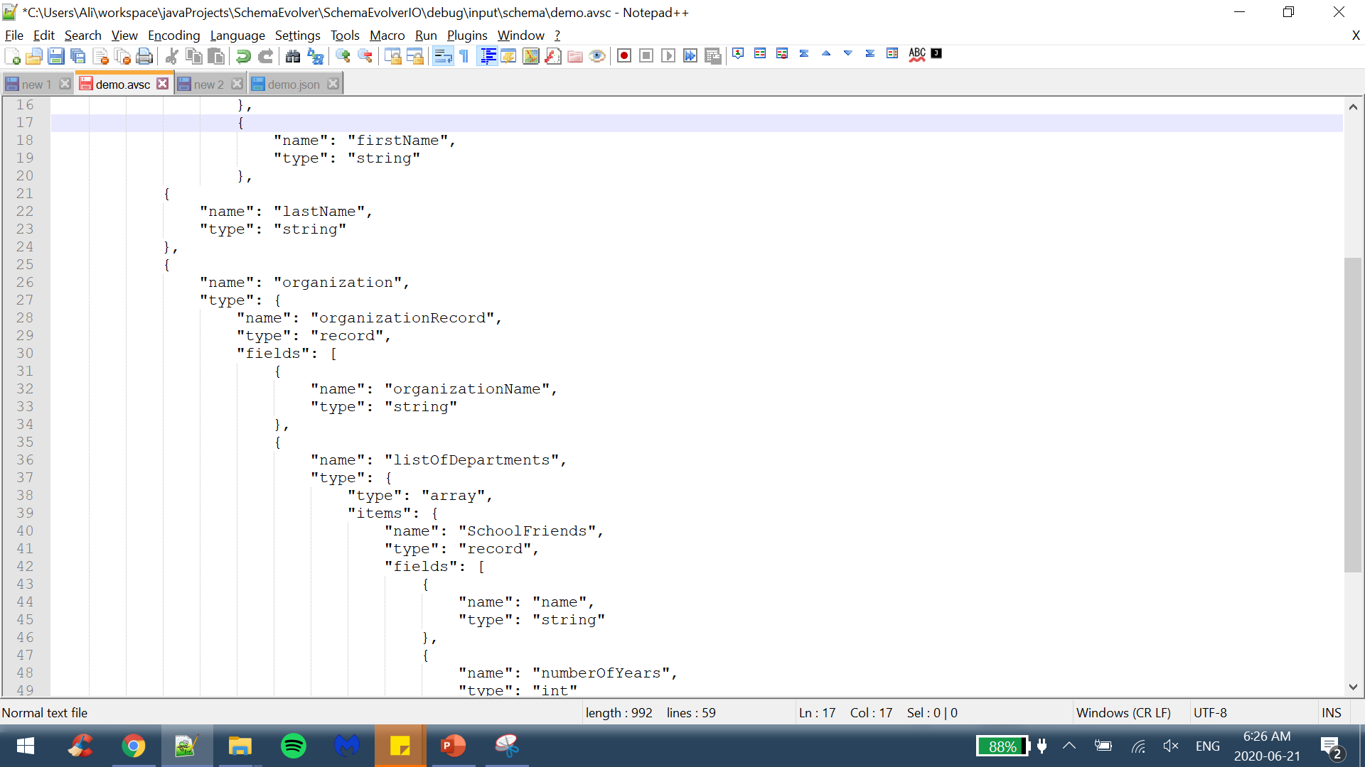
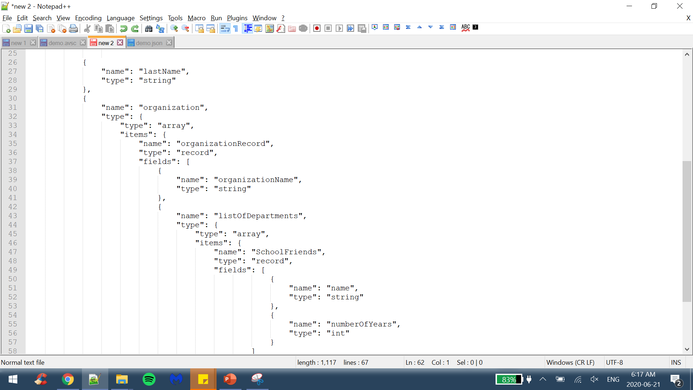
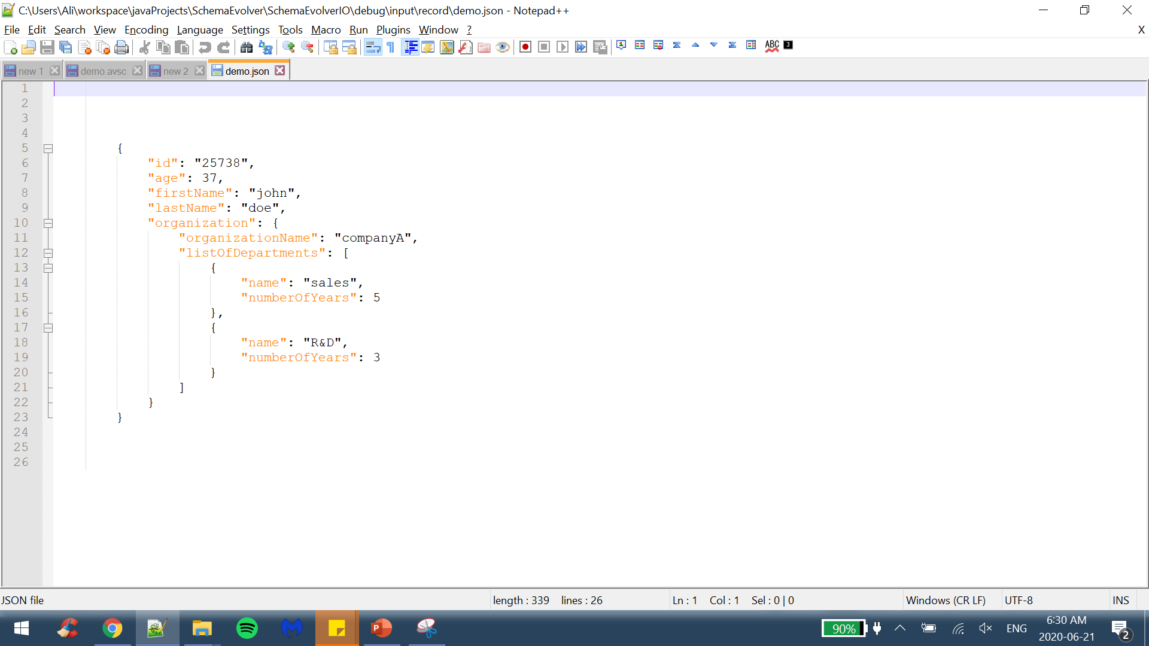
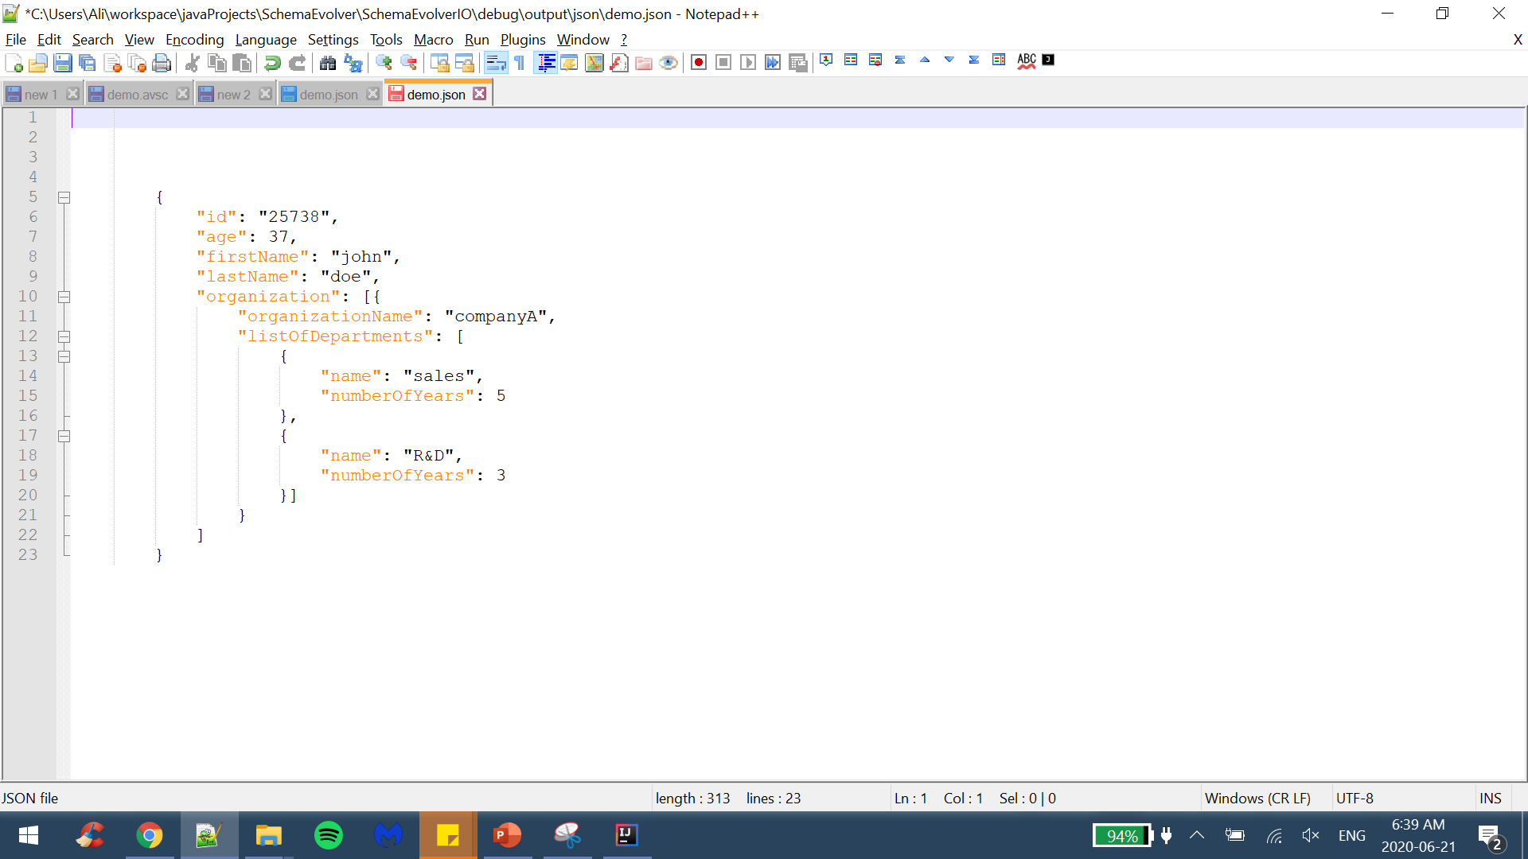
old schema
new schema
old record
new record

Slide 6

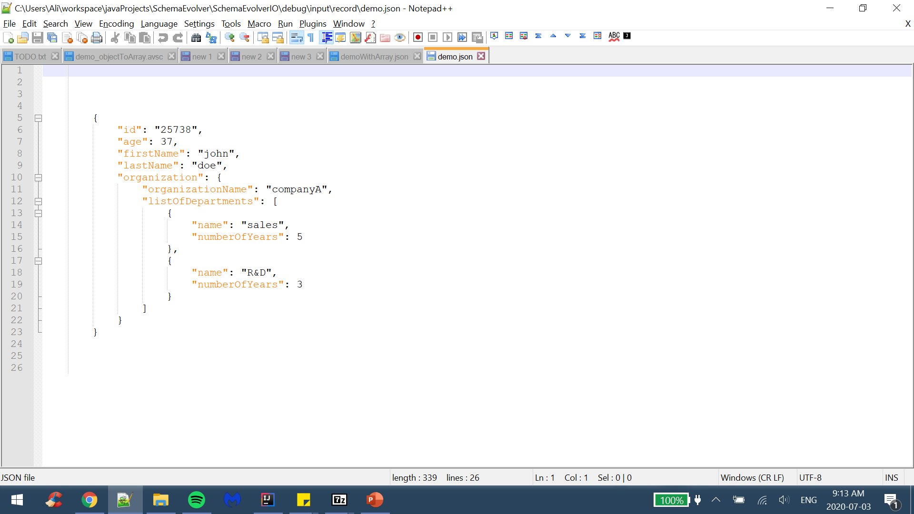
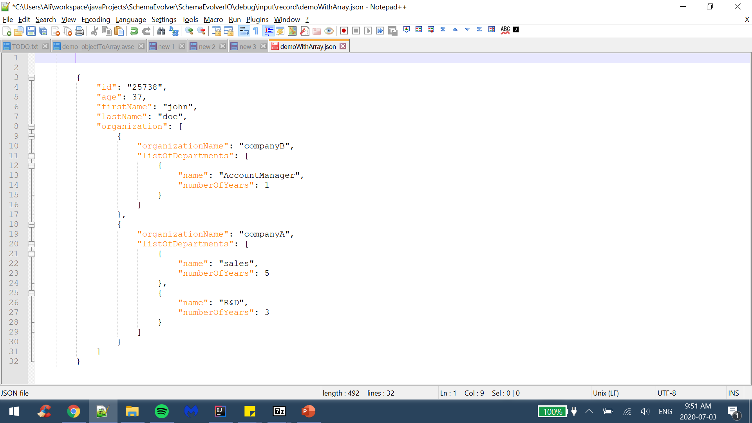
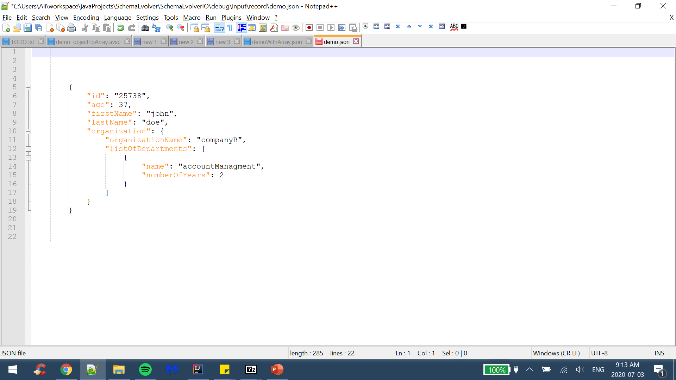
new records
old schema
new schema
old record

Slide 7
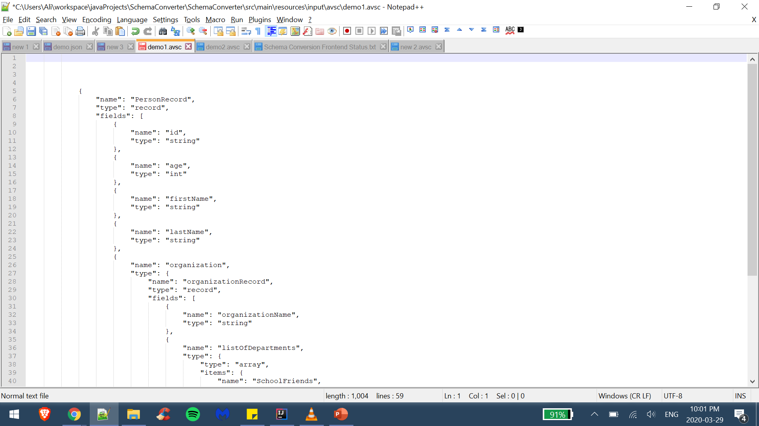
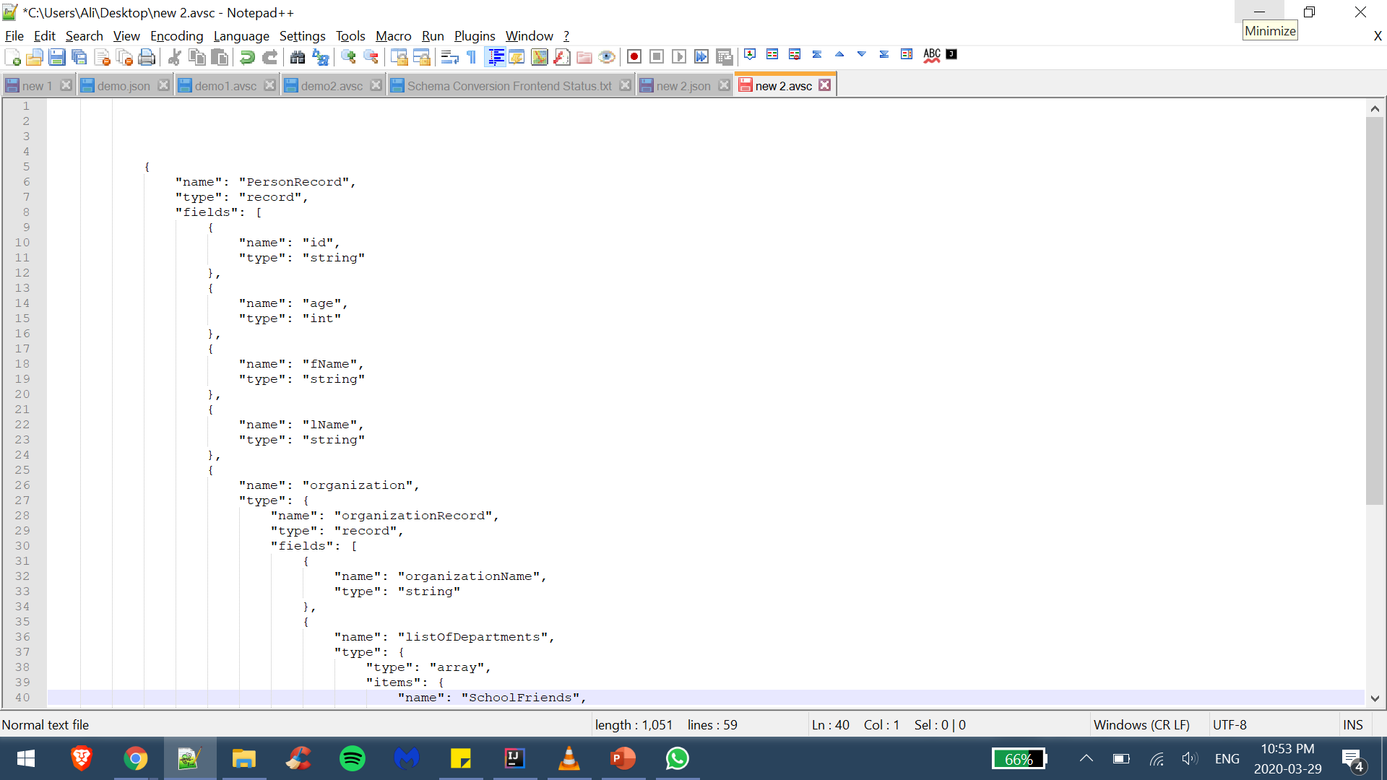
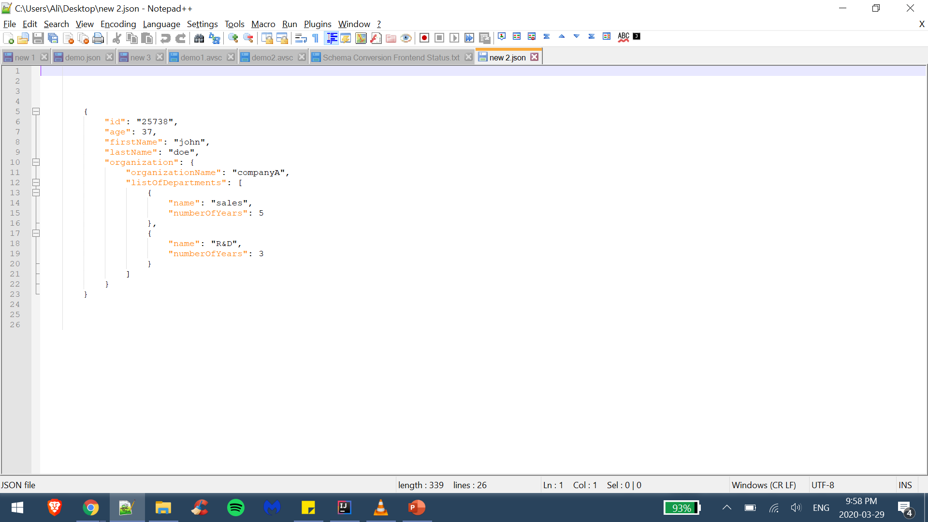
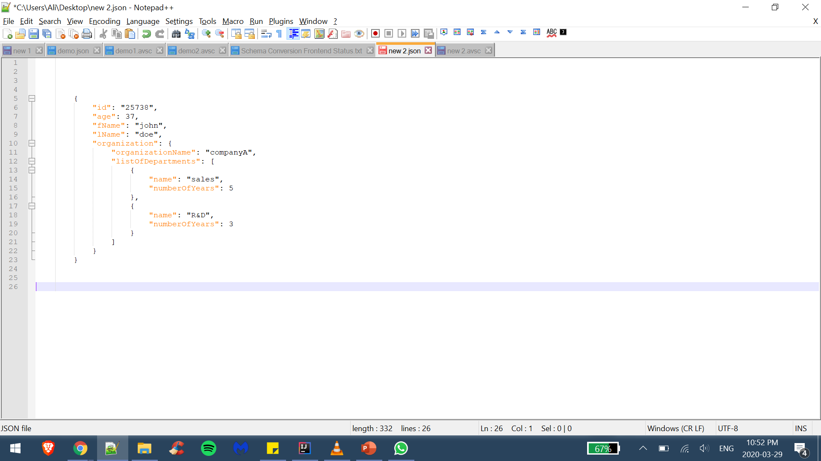
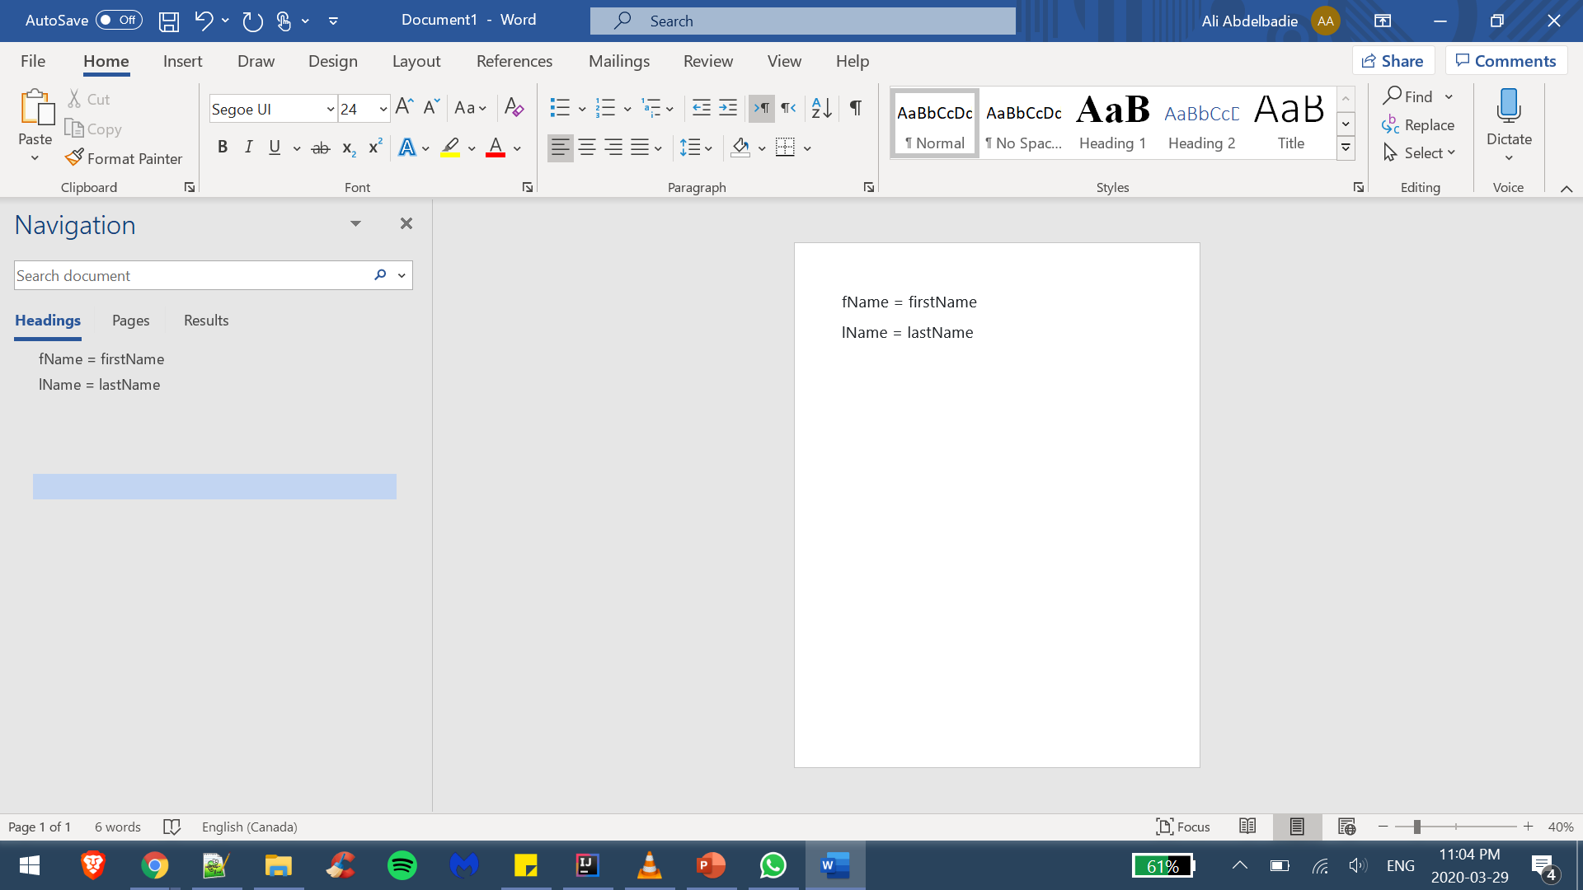
old schema
new schema
old record
new record
renamed list

Slide 8
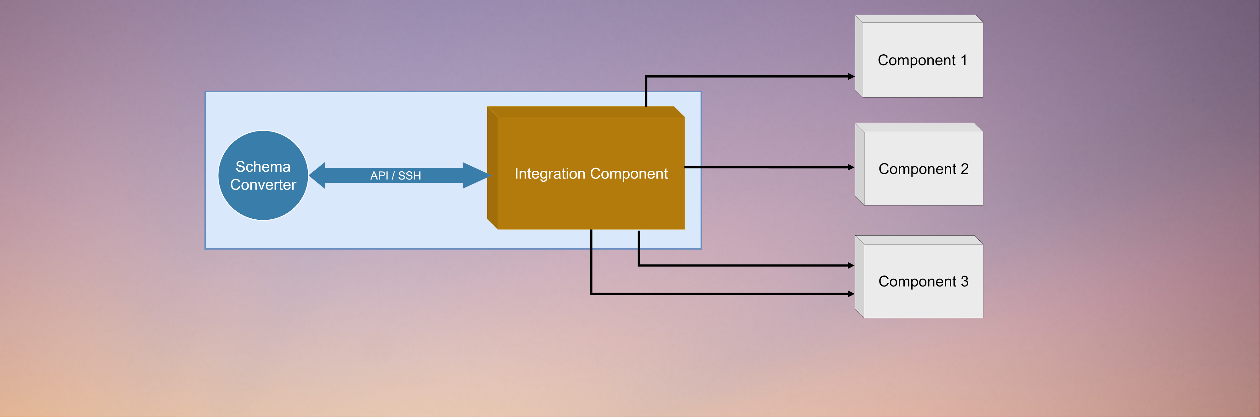

Slide 9
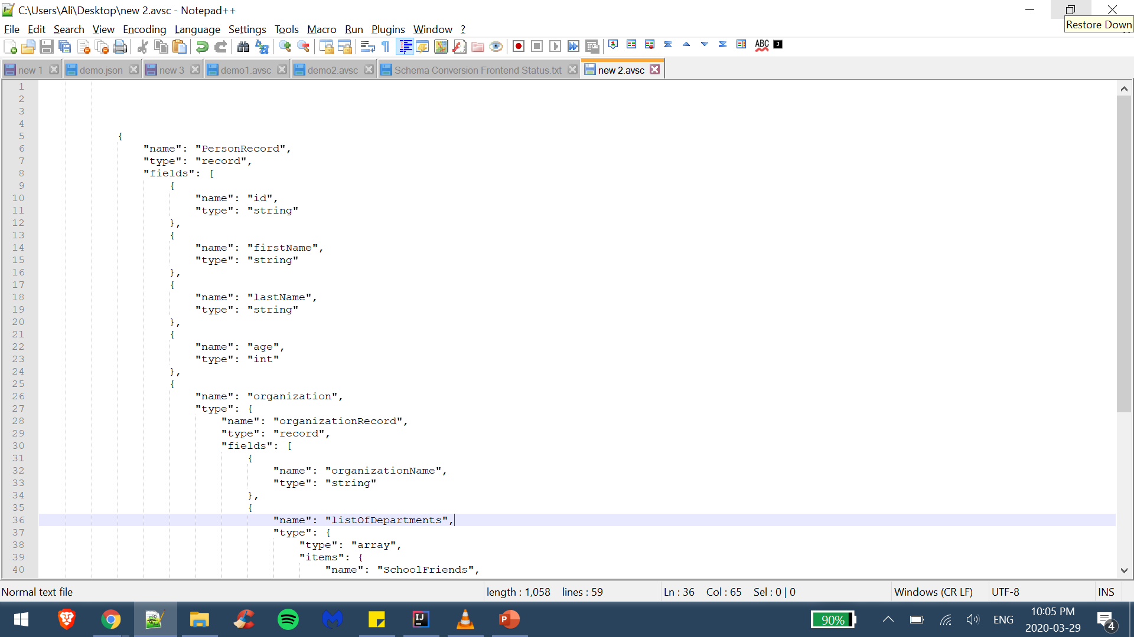
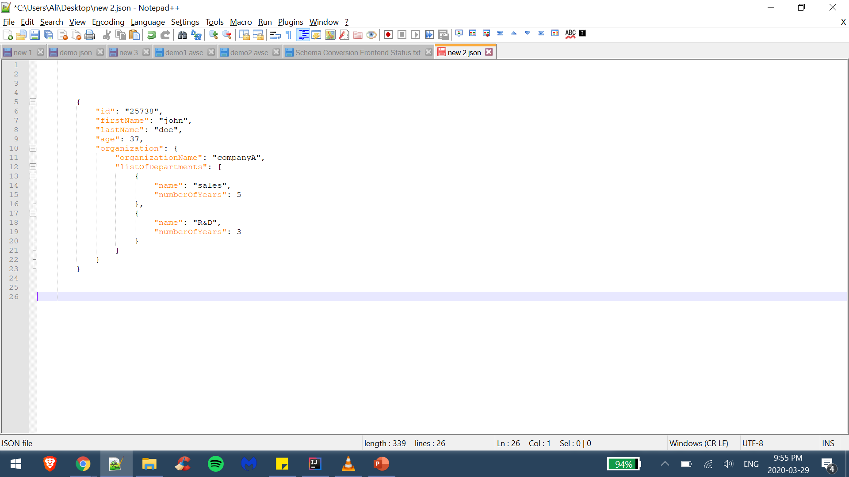
old schema
new schema
old record
new record

Slide 10
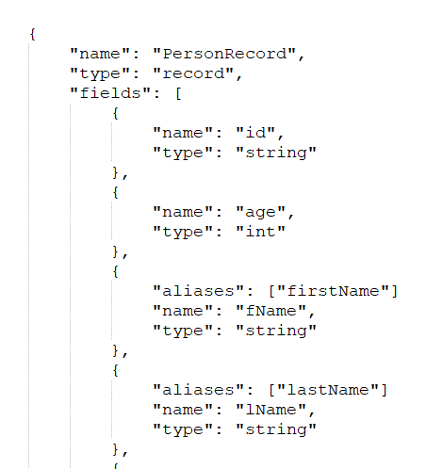
old schema
new schema
old record
new record

Slide 11
Shape cutout from screenshot
https://blog.slidemagic.com/blog/2018/1/9/how-to-cut-out-shapes-out-of-images-in-powerpoint

Slide 15


Slide 16


Slide 17


